Slide 1

Automatic Road pavement assessment
Team - ATOM

Slide 2
Problem statement
The proposed solution aims to the provide a system to automatically assess the picture taken during inspection and identify common issues such as shoulder clearance, potholes, road furniture etc.
The solution will also provide a user interface to locate the issues along each route. This thereby helps automate the monitoring process.

Slide 3
Modules
Road Quality Index
Road Damage Type Detection
Traffic Sign Detection

Slide 4
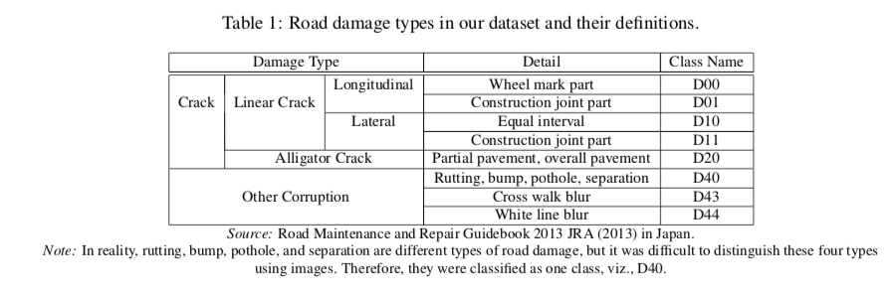
Road Damage type detection – Dataset
Road Damage Dataset contains 163,664 Annotated images of 600 * 600 pixles. Annotated images are presented as the same format to PASCAL VOC.

Slide 5
Road Damage type detection – model
MobileNet (Howard et al., 2017) has been shown toachieve an accuracy comparable to VGG-16 on Ima-geNet with only 1/30th of the computational cost andmodel size

Slide 6
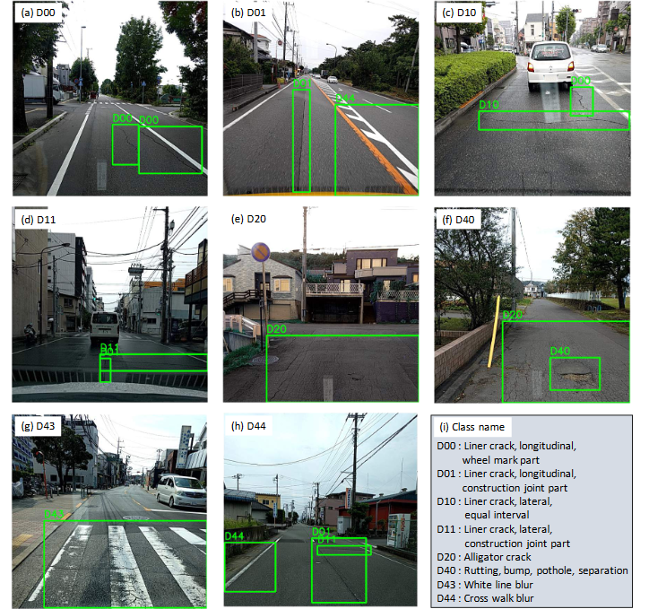
Road Damage type detection – sample images

Slide 7
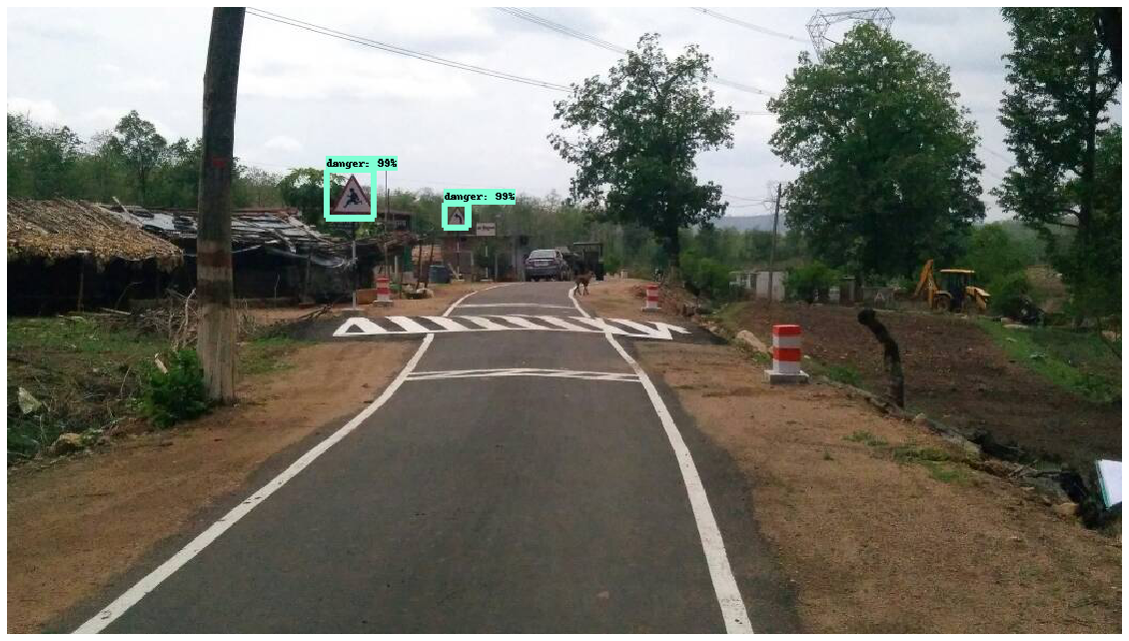
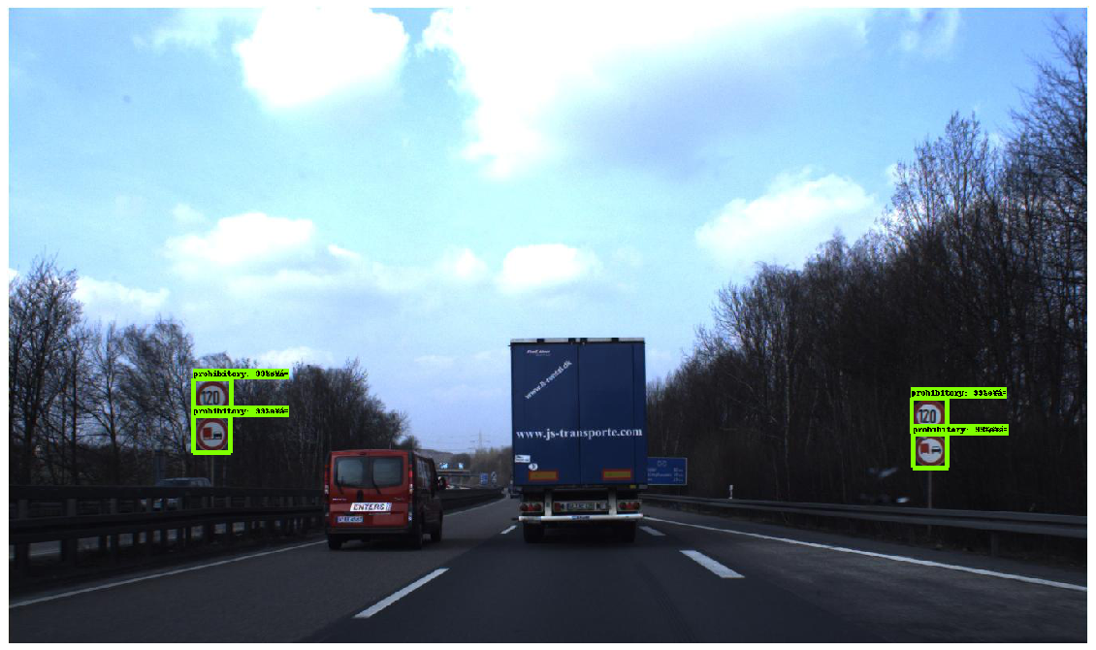
Traffic sign detection – Dataset
German Traffic Sign Detection Benchmark contains 900 images (divided into 600 training images and 300 evaluation images)

Slide 8
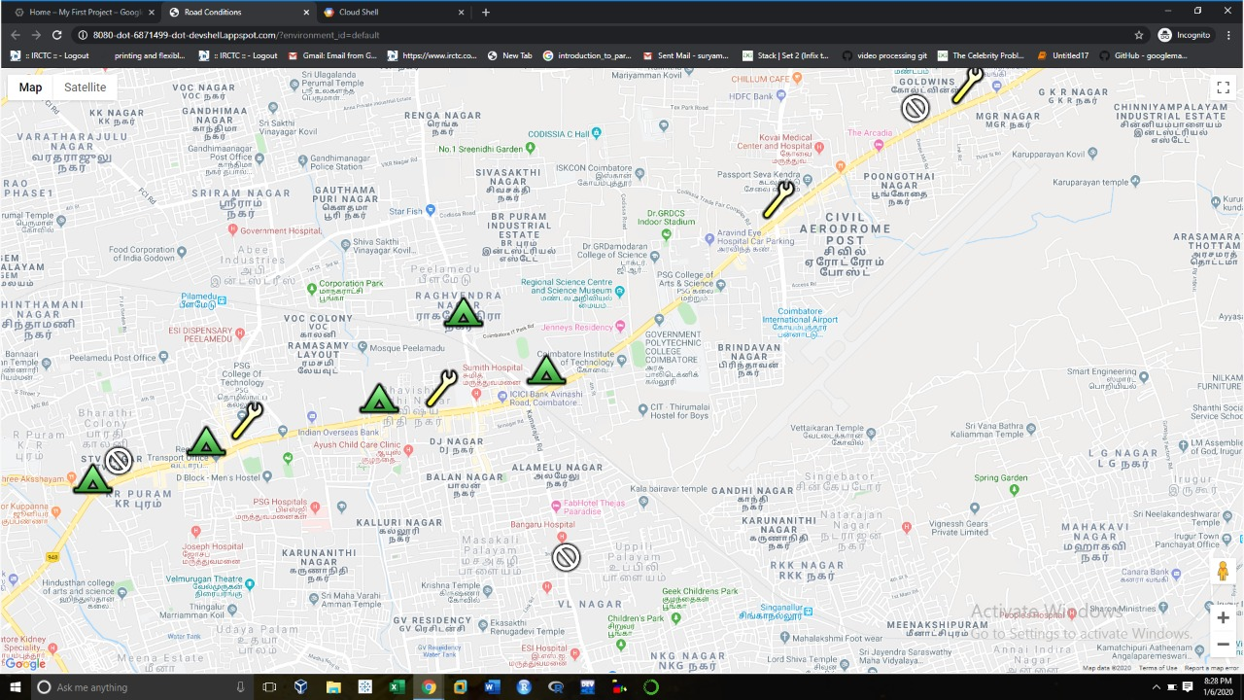
UI

